Slide 1

DBMS Project Review 1
Team no : 26
Team members :
Kironmoy Mukherjee (RA2311030010129)
Aditya Khandelwal (RA2311030010130)

Slide 2
GIG SPHERE
A Freelance Management

Slide 3
CONTENT
ProblemStatement
1
Objective
2
Abstract
3
Phases
4

Slide 4
PROBLEM STATEMENT
Freelance work has grown, yet both clients and freelancers face challenges like inefficient contract management, delayed payments, and trust issues. Clients struggle with finding reliable freelancers and secure financial transactions, while freelancers deal with unfair contract changes and payment disputes. GigSphere solves these problems with structured proposal tracking, milestone-based payments, flexible contracts, and endorsement-based credibility, creating a fair and efficient ecosystem.

Slide 5
OBJECTIVE
GigSphere aims to create a structured freelancing platform that enhances trust, efficiency, and security for both clients and freelancers. It provides seamless contract management, transparent dispute resolution, and endorsement-based credibility, ensuring a fair and reliable freelancing experience.

Slide 6
ABSTRACT
GigSphere streamlines freelance project management by addressing contract inefficiencies, payment disputes, and trust issues. It offers transparent contract tracking, milestone-based payments, endorsement-based credibility, and structured work submissions to ensure smooth collaboration. With integrated support and dispute resolution, clients and freelancers can manage projects securely and efficiently. Built with PostgreSQL, Flask, and AWS/Heroku, GigSphere delivers a reliable, transparent, and scalable freelancing platform.

Slide 7
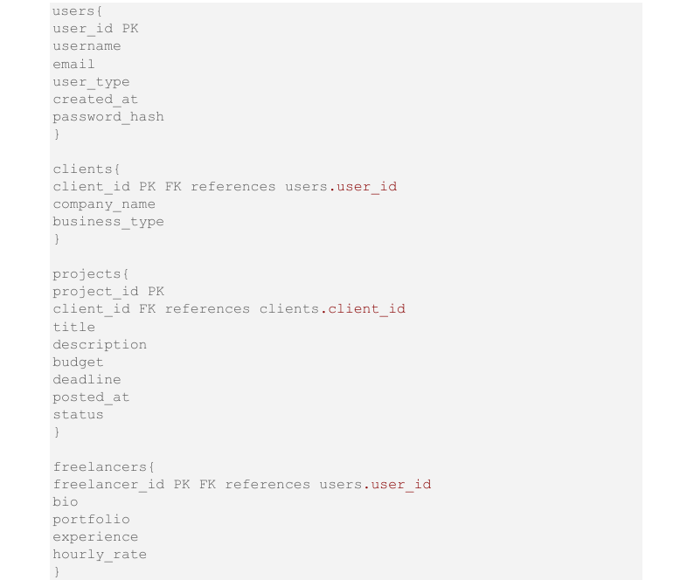
ENTITIES

Slide 8
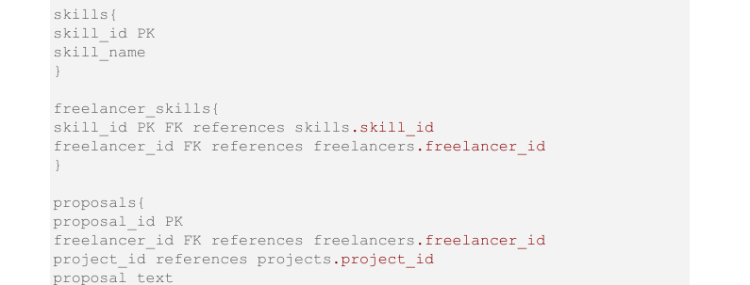
ENTITIES

Slide 9
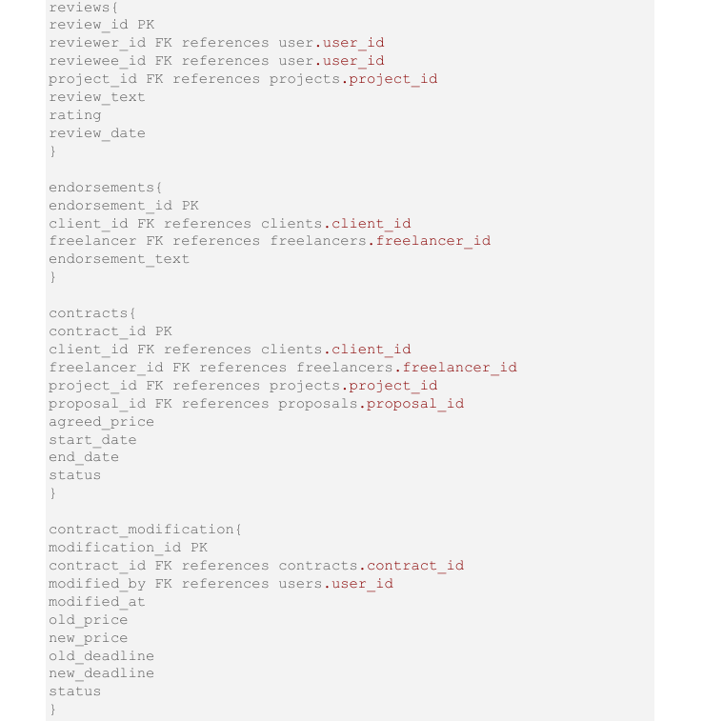
ENTITIES

Slide 10
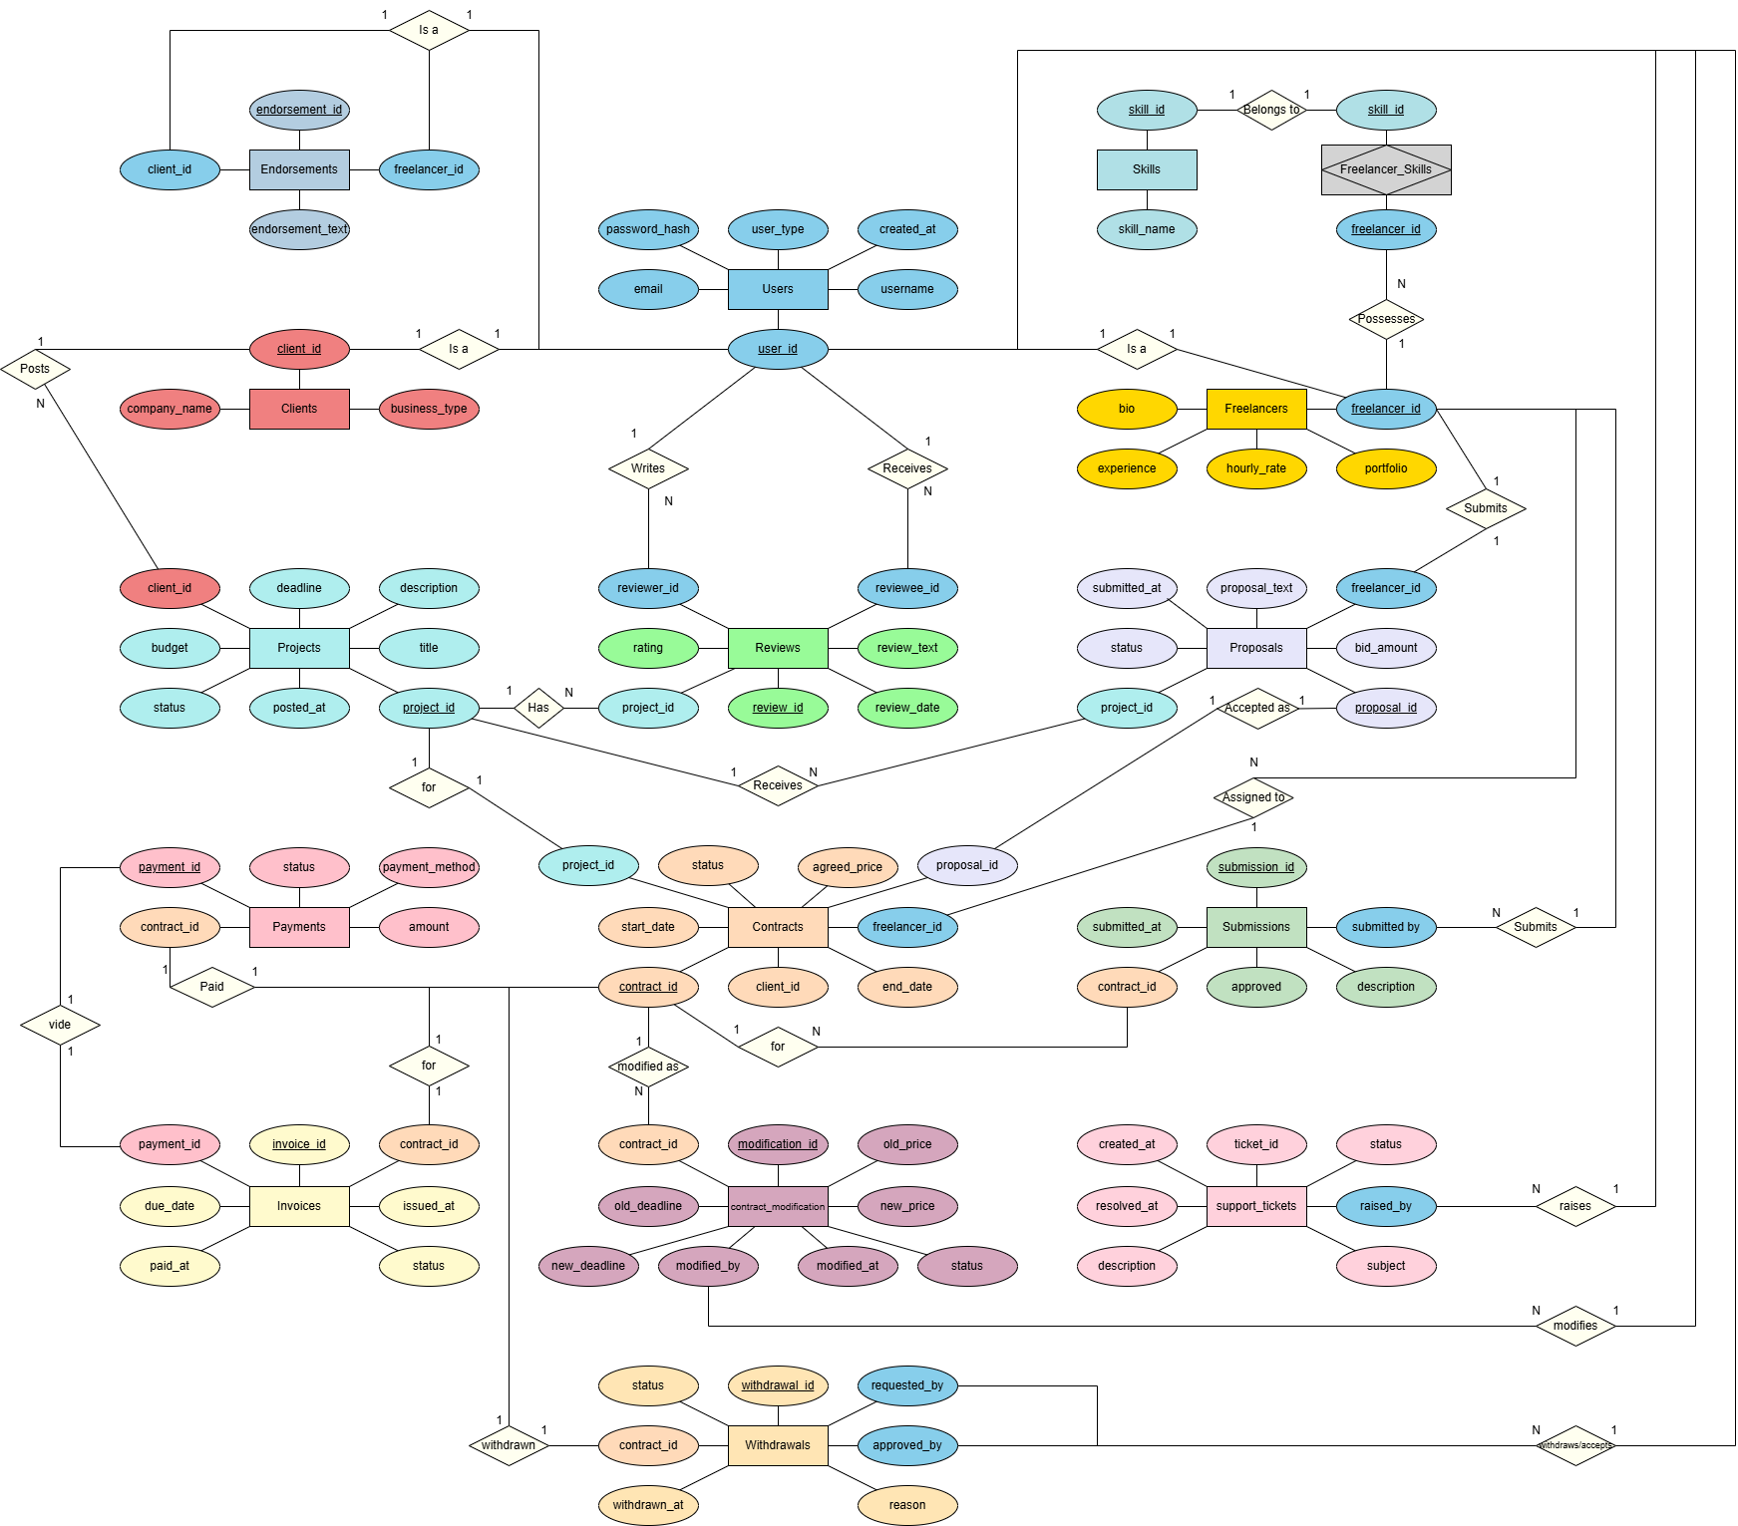
ABSTRACT

Slide 11
PHASES
PHASE 1:- Database Design & Setup
Design a E-R diagram , Schema , Table
Establish PostgreSQL database with foreign key constraints
PHASE 2:- Backend Development
Create APIs for user authentication , project handling , proposals , etc.
Implementing RESTFUL API for data communication

Slide 12
PHASES
PHASE 3:- Frontend Development
Develop HTML/CSS/JavaScri-pt UI
Integrate forms of proposals , contracts ,and payments
PHASE 4:- Integrity and testing
Connects frontend , backend with API calls
Conduct testing for security , payments , and data integrity

Slide 13
PHASES
PHASE 5:-Development and Enhancements
Deploy system on a cloud server (eg - AWS Heroku)
Optimize performance and scalability

Slide 14
SOFTWARE REQUIREMENTS
Operating System: Windows / Linux / macOS
Backend: Flask (Python), PostgreSQL, SQLAlchemy
Frontend: HTML, CSS, JavaScript (or React.js)
Development Tools: VS Code, PGAdmin
Libraries: Flask-MySQL, Flask-RESTful, JWT for authentication

Slide 15
HARDWARE REQUIREMENTS
Processor : Intel i3 / Ryzen 5 or better
RAM : Minimum 2GB or better
Storage : Minimum 5GB free

Slide 16
CONCLUSION
GigSphere aims to simplify freelance work management, ensuring efficiency, security, and transparency.
With a structured database, user-friendly UI, and secure contracts, it provides a comprehensive solution for freelancers and clients. Through phase-wise implementation, GigSphere can evolve into a scalable freelance marketplace.

Slide 17
THANK
YOU

